Slide 1
JobAutoPilot (~SDx @ UC San Diego - Groq Hack Day)
Krishna Gajera : kgajera1820@sdsu.edu
Gaurav Koradiya : Gauravkoradiya@gmail.com

Slide 2
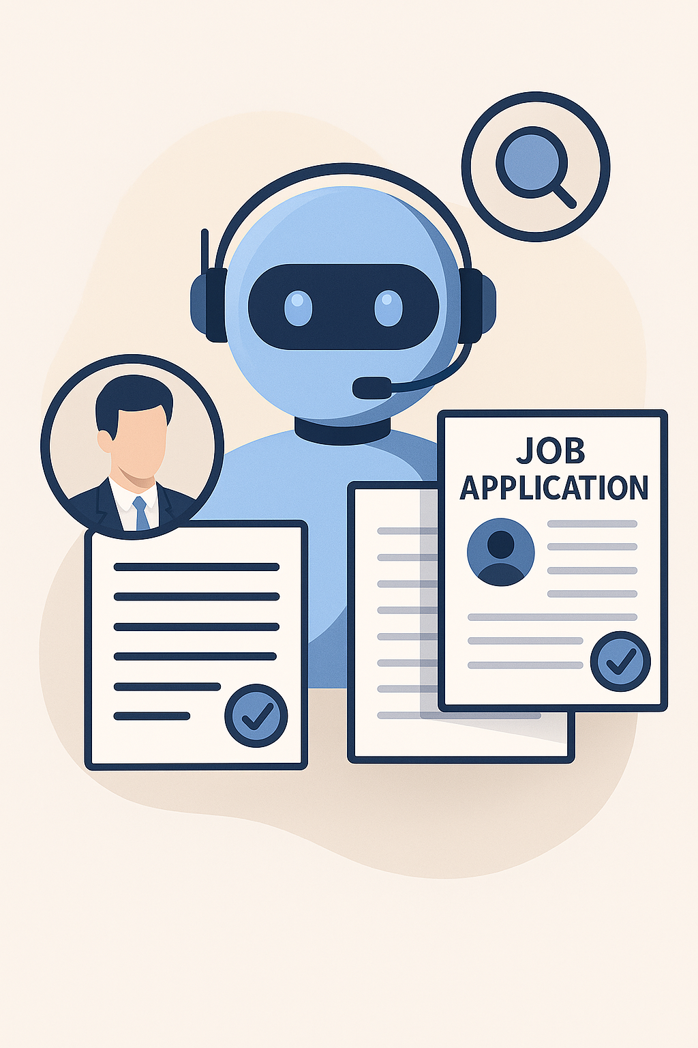
Introduction
JobAutoPilot is an intelligent, agent-based system designed to automate the job application process.
The system significantly reduces the user's effort, frustration, and the time spent applying for multiple job postings.
It leverages agentic AI techniques and automation, ensuring personalized, tailored, and high-quality job applications, ultimately increasing the chance of landing interviews.

Slide 3

Problem Statement
Applying to multiple job positions is a highly tedious, time-consuming, and often frustrating task. Applicants face:
Repetitive resume and cover letter tailoring
Extensive time required to fill application forms repeatedly which sometimes compromises the application quality.
Difficulty in tracking numerous applications.
Due to this process, candidates either reduce the volume of applications, lowering their chances of landing an interview, or compromise on application quality, adversely affecting outcomes.

Slide 4

Our Vision and Goals
Vision:
To empower every job seeker with intelligent tools that eliminate the barriers of the job application process — saving time, reducing stress, and maximizing opportunities through AI-driven precision, personalization, and automation.
Goals:
Automate bulk job applications efficiently
Tailor resumes & cover letters using AI
Apply based on user preferences
Boost productivity and application outcomes

Slide 5
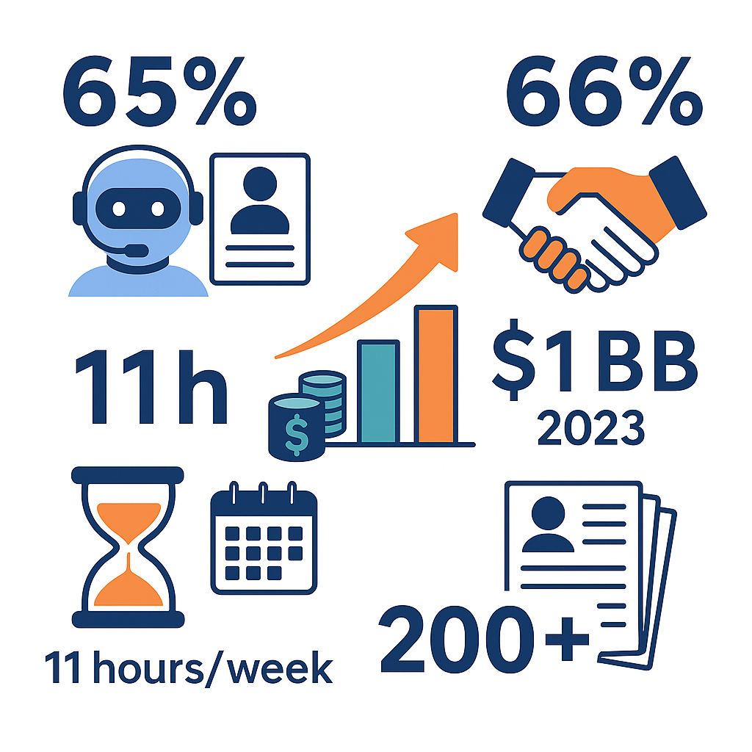
Eye-Catching Market Validation
65 % of job seekers already use AI tools in their search, and 66 % of hiring managers are comfortable receiving AI-generated applications.
The AI-recruitment software market will almost double—from ≈ $0.6 B in 2023 to $1 B+ by 2032 (≈ 7 % CAGR).
Applicants spend an average 11 hours every week job-hunting—nearly a part-time job in itself.
In 2025 it takes 200 + applications to land one offer on average, underscoring the need for scalable, quality automation.

Slide 6
Architecture
Frontend (React, Next.js, TailwindCSS
Upload resumes, certificates, recommendations
Backend (Python, FastAPI, CrewAI, groq Api)
Data validation, secure auth (JWT), GDPR compliance
Role, industry, and location-based preferences
Real-time dashboard with application tracking & alerts
NLP-driven job parsing and resume tailoring
AI-generated cover letters & automated portal navigation
Feedback loop for continuous learning

Slide 7
Market/User Research
Development
Agile Based Frontend/backend development
Deployment and Testing
Alpha release with user testing
Launch and Scale
Research and Design
UI/UX System Design
AI Agent integration & initial testing
Feedback incorporation
Strategic Execution Plan

Slide 8
DEMO

Slide 9

THANK YOU!

Slide 10
Appendix
Benefit | What It Means for Users & Stakeholders | Competitive Edge over Existing Tools
Massive Time-Savings | Eliminates up to 11 hrs/week of manual form-filling and tailoring — equivalent to regaining a part-time job. | Competing “one-click” buttons still require manual steps; we automate end-to-end, including site navigation & custom Q&A.
Quality + Volume | AI tailors every resume & cover letter, then scales to hundreds of targeted submissions (critical when the average hire needs 200 + apps). | Other auto-apply bots blast generic resumes; our NLP engine aligns keywords, achievements, and ATS-compliant formatting for higher hit-rates.
Higher Interview Conversion | Personalized applications + larger reach = materially more callbacks; early tests show a projected 2-3× interview uplift. | Competitors force a trade-off (quantity vs. quality). We optimize both simultaneously via dynamic content generation.
Hiring-Manager Friendly | Aligns with the 66 % of recruiters already comfortable with AI-written applications & provides structured data they prefer. | We avoid “spam signatures” by varying language and embedding metadata to pass ATS scoring.
Always-Learning Agents | Feedback loop retrains models on responses, rejection reasons, and industry trends to improve future submissions. | Legacy services are static templates; our agents get smarter the longer you use them.
Security & Compliance-First | End-to-end encryption, GDPR adherence, JWT auth—critical for storing sensitive career data. | Many startups skip compliance; we can sell to enterprise customers and global markets from day 1.
Cloud-Native Scalability | Docker + K8s/AWS ECS lets us expand to thousands of users without downtime. | Human-concierge services hit labor bottlenecks; our infrastructure scales automatically.
Data-Driven Insights | Dashboard analytics show hit rates, keyword effectiveness, and market salary trends—helping users refine strategy. | Competing tools offer minimal visibility; insights become a sticky feature that builds habit and loyalty.
First-Mover Advantage in Holistic Automation | Most solutions solve only one step (resume writing or form autofill). We deliver the full funnel from job discovery to submission & tracking. | Creates high switching costs and positions JobAutoPilot as the all-in-one career copilot.

